Slide 1
Foundations of Machine Learning
Module 6: Neural Network
Part C: Neural Network and Backpropagation Algorithm
Sudeshna Sarkar
IIT Kharagpur

Slide 2
Single layer Perceptron
Single layer perceptrons learn linear decision boundaries
o
x
x₂
0
0
0
0
o
o
+ + + + + +
0
0
0
x: class I (y = 1)
o: class II (y = -1)
x₁
x
x
x₂
+
0
o
x
0
+
x: class I (y = 1)
o: class II (y = -1)
x₁
xor

Slide 3
Boolean OR
x₂
+
+
OR
−
+
x₁
input x1 | input x2 | ouput
0 | 0 | 0
0 | 1 | 1
1 | 0 | 1
1 | 1 | 1
w₀= −0.5
1
w₁=1
w₂=1
x₁
x₂

Slide 4
Boolean AND
x₂
−
+
AND
input x1 | input x2 | ouput
0 | 0 | 0
0 | 1 | 0
1 | 0 | 0
1 | 1 | 1
−
−
x₁
w₀= −1.5
1
w₁=1
w₂=1
x₁
x₂

Slide 5
Boolean XOR
x₂
+
−
XOR
input x1 | input x2 | ouput
0 | 0 | 0
0 | 1 | 1
1 | 0 | 1
1 | 1 | 0
−
+
x₁

Slide 6
Boolean XOR
XOR
o
−0.5
input x1 | input x2 | ouput
0 | 0 | 0
0 | 1 | 1
1 | 0 | 1
1 | 1 | 0
1
−1
OR
AND
−0.5
h₁
h₁
−1.5
1
1
1
1
x₁
x₁

Slide 7
Representation Capability of NNs
Single layer nets have limited representation power (linear separability problem). Multi-layer nets (or nets with non-linear hidden units) may overcome linear inseparability problem.
Every Boolean function can be represented by a network with a single hidden layer.
Every bounded continuous function can be approximated with arbitrarily small error, by network with one hidden layer
Any function can be approximated to arbitrary accuracy by a network with two hidden layers.

Slide 8
Multilayer Network

Slide 9
Two-layer back-propagation neural network

Slide 10
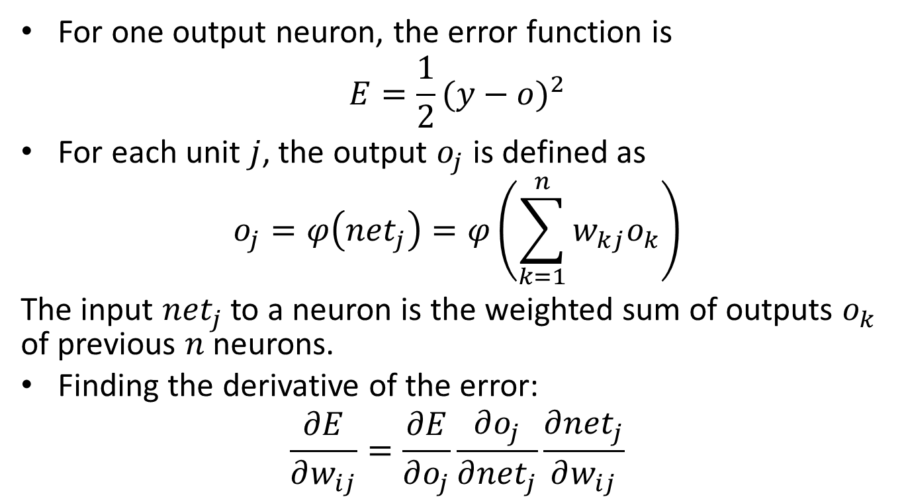
Derivation
For one output neuron, the error function is
$$E=\frac{1}{2}{(y−o)}^{2}$$
For each unit $j$, the output $o_{j}$ is defined as
$$o_{j}=φ\left({net}_{j}\right)=φ\left(\sum_{k=1}^{n}{w_{kj}o_{k}}\right)$$
The input ${net}_{j}$ to a neuron is the weighted sum of outputs $o_{k}$ of previous $n$ neurons.
Finding the derivative of the error:
$$\frac{∂E}{∂w_{ij}}=\frac{∂E}{∂o_{j}}\frac{∂o_{j}}{∂{net}_{j}}\frac{∂{net}_{j}}{∂w_{ij}}$$

Slide 11
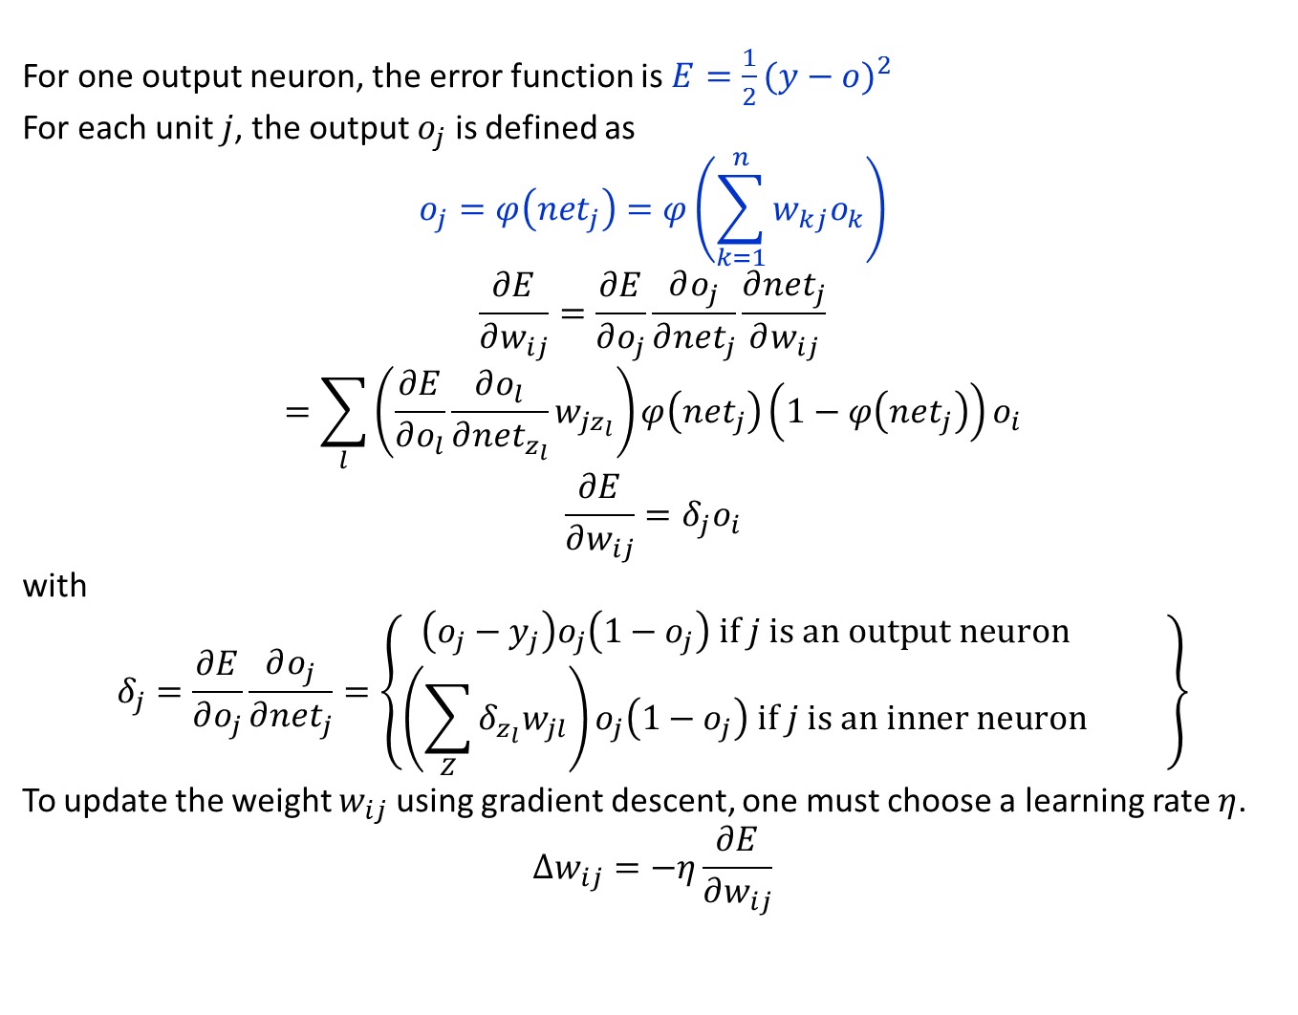
For one output neuron, the error function is $E=\frac{1}{2}{(y−o)}^{2}$
For each unit $j$, the output $o_{j}$ is defined as
$$o_{j}=φ\left({net}_{j}\right)=φ\left(\sum_{k=1}^{n}{w_{kj}o_{k}}\right)$$
$$\frac{∂E}{∂w_{ij}}=\frac{∂E}{∂o_{j}}\frac{∂o_{j}}{∂{net}_{j}}\frac{∂{net}_{j}}{∂w_{ij}}$$
$$=\sum_{l}{\left(\frac{∂E}{∂o_{l}}\frac{∂o_{l}}{∂{net}_{z_{l}}}w_{jz_{l}}\right)}φ\left({net}_{j}\right)\left(1−φ\left({net}_{j}\right)\right)o_{i}$$
$$\frac{∂E}{∂w_{ij}}=δ_{j}o_{i}$$
with
$$δ_{j}=\frac{∂E}{∂o_{j}}\frac{∂o_{j}}{∂{net}_{j}}=\left\{\begin{matrix}\left(o_{j}−y_{j}\right)o_{j}\left(1−o_{j}\right) if j is an output neuron \\ \left(\sum_{Z}{δ_{z_{l}}w_{jl}}\right)o_{j}\left(1−o_{j}\right) if j is an inner neuron\end{matrix} \right\}$$
To update the weight $w_{ij}$ using gradient descent, one must choose a learning rate $η$.
$$∆w_{ij}=−η\frac{∂E}{∂w_{ij}}$$

Slide 12

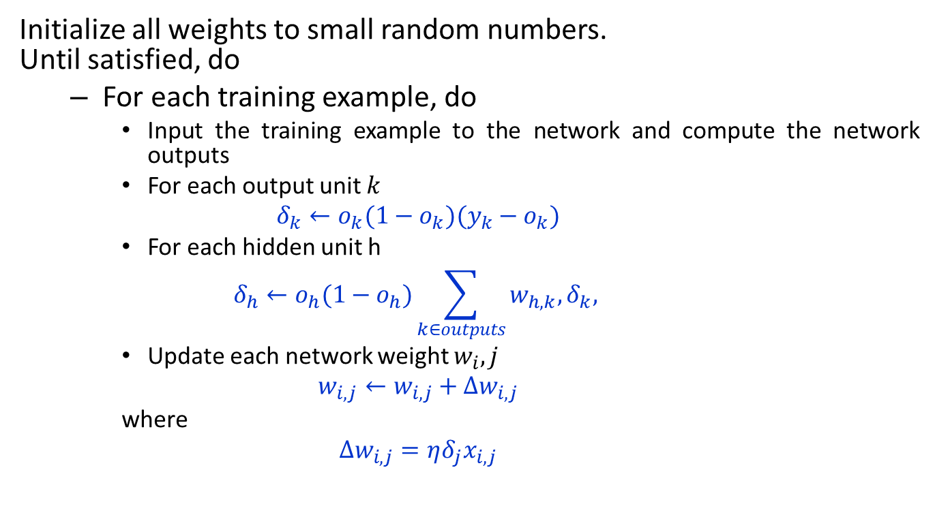
Backpropagation Algorithm
Initialize all weights to small random numbers. Until satisfied, do
For each training example, do
Input the training example to the network and compute the network outputs
For each output unit $k$
$$δ_{k}←o_{k}(1−o_{k})(y_{k}−o_{k})$$
For each hidden unit h
$$δ_{h}←o_{h}(1−o_{h})\sum_{k∈outputs}{w_{h,k},δ_{k}, }$$
Update each network weight $w_{i}, j$
$$w_{i,j}←w_{i,j}+∆w_{i,j}$$
where
$$∆w_{i,j}=ηδ_{j}x_{i,j}$$
$x_{d}$ = input
$y_{d}$ = target output
$o_{d}$ = observed unit output
$w_{ij}$ = wt from i to j

Slide 13
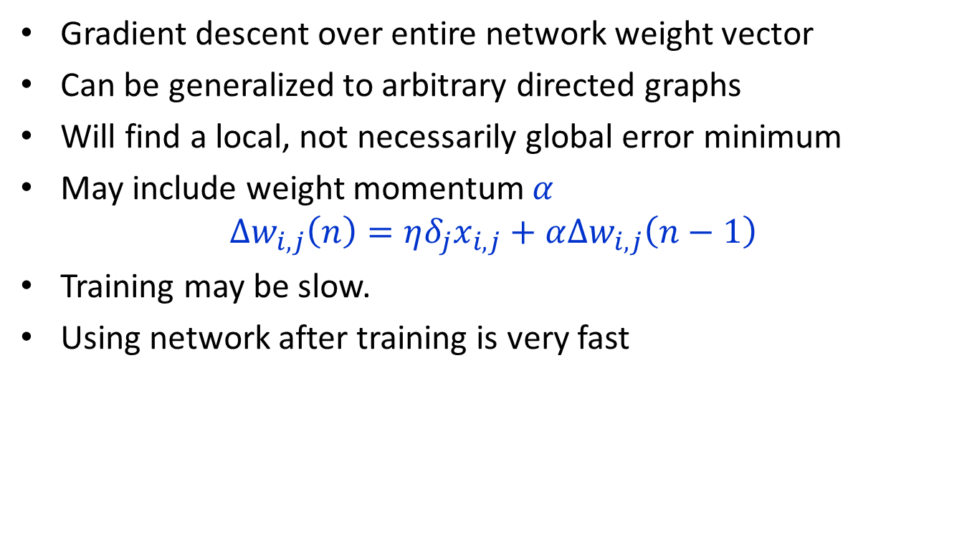
Backpropagation
Gradient descent over entire network weight vector
Can be generalized to arbitrary directed graphs
Will find a local, not necessarily global error minimum
May include weight momentum $α$
$$∆w_{i,j}\left(n\right)=ηδ_{j}x_{i,j}+α∆w_{i,j}\left(n−1\right)$$
Training may be slow.
Using network after training is very fast

Slide 14
Training practices: batch vs. stochastic vs. mini-batch gradient descent
Batch gradient descent:
Calculate outputs for the entire dataset
Accumulate the errors, back-propagate and update
Stochastic/online gradient descent:
Feed forward a training example
Back-propagate the error and update the parameters
Mini-batch gradient descent:
Too slow to converge
Gets stuck in local minima
Converges to the solution faster
Often helps get the system out of local minima

Slide 15
Learning in epochs Stopping
Train the NN on the entire training set over and over again
Each such episode of training is called an “epoch”
Stopping
Fixed maximum number of epochs: most naïve
Keep track of the training and validation error curves.

Slide 16
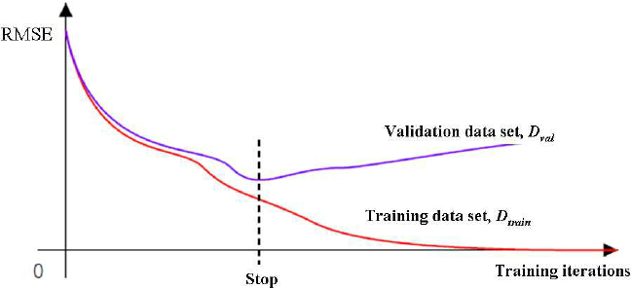
Overfitting in ANNs

Slide 17
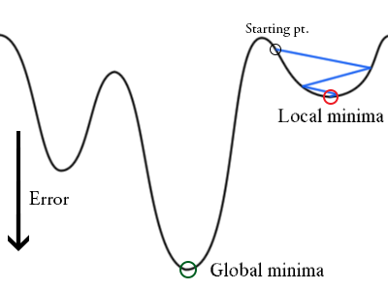
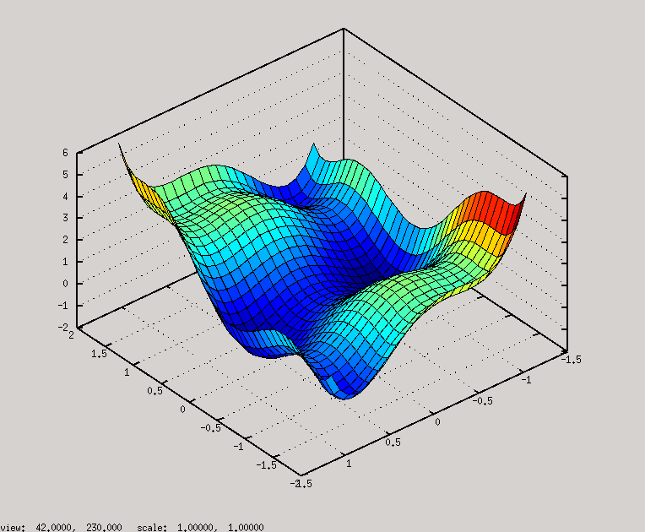
Local Minima
NN can get stuck in local minima for small networks.
For most large networks (many weights) local minima rarely occurs.
It is unlikely that you are in a minima in every dimension simultaneously.

Slide 18
ANN
Highly expressive non-linear functions
Highly parallel network of logistic function units
Minimizes sum of squared training errors
Can add a regularization term (weight squared)
Local minima
Overfitting

Slide 19
Thank You

